Slide 1






Comparison of particle trajectories and collision operators for collisional transport in nonaxisymmetric plasmas
Matt Landreman, (University of Maryland, MIT, ORISE)
Håkan Smith, Per Helander (IPP Greifswald)
arXiv: 1312.6058 (2013)
Notes:
Figure was generated using m20131226_02_sfincsNSpecies_pictureFor1stPowerpointSlide.m

Slide 2
Outline
Overview of new stellarator drift-kinetic code SFINCS.
Variants of the drift-kinetic equation, differing in the E_{r} terms.
Results: the different kinetic equations lead to indistinguishable predictions when E_{r} < E_{r}^{res} / 3, but can differ substantially otherwise.
Comparison of collision operators.

Slide 3
SFINCS (Stellarator Fokker-Planck Iterative Neoclassical Conservative Solver)
Solves time-independent drift-kinetic equations for f_{s}(θ, ζ, υ⊥, υ||).

Slide 4
SFINCS (Stellarator Fokker-Planck Iterative Neoclassical Conservative Solver)
Solves time-independent drift-kinetic equations for f_{s}(θ, ζ, υ⊥, υ||).
Several options for terms in the kinetic equation involving E_{r} – “effective particle trajectories.”

Slide 5
SFINCS (Stellarator Fokker-Planck Iterative Neoclassical Conservative Solver)
Solves time-independent drift-kinetic equations for f_{s}(θ, ζ, υ⊥, υ||).
Several options for terms in the kinetic equation involving E_{r} – “effective particle trajectories.”
Several options for collision operator, including full linearized Fokker-Planck.

Slide 6
SFINCS (Stellarator Fokker-Planck Iterative Neoclassical Conservative Solver)
Solves time-independent drift-kinetic equations for f_{s}(θ, ζ, υ⊥, υ||).
Several options for terms in the kinetic equation involving E_{r} – “effective particle trajectories.”
Several options for collision operator, including full linearized Fokker-Planck.
Continuum discretization, with mix of finite-difference, spectral, and pseudospectral methods.

Slide 7
SFINCS (Stellarator Fokker-Planck Iterative Neoclassical Conservative Solver)
Solves time-independent drift-kinetic equations for f_{s}(θ, ζ, υ⊥, υ||).
Several options for terms in the kinetic equation involving E_{r} – “effective particle trajectories.”
Several options for collision operator, including full linearized Fokker-Planck.
Continuum discretization, with mix of finite-difference, spectral, and pseudospectral methods.
General nested flux surface geometry allowed, with interface to equilibrium data.

Slide 8
SFINCS (Stellarator Fokker-Planck Iterative Neoclassical Conservative Solver)
Solves time-independent drift-kinetic equations for f_{s}(θ, ζ, υ⊥, υ||).
Several options for terms in the kinetic equation involving E_{r} – “effective particle trajectories.”
Several options for collision operator, including full linearized Fokker-Planck.
Continuum discretization, with mix of finite-difference, spectral, and pseudospectral methods.
General nested flux surface geometry allowed, with interface to equilibrium data.
Multiple species.

Slide 9
SFINCS (Stellarator Fokker-Planck Iterative Neoclassical Conservative Solver)
Solves time-independent drift-kinetic equations for f_{s}(θ, ζ, υ⊥, υ||).
Several options for terms in the kinetic equation involving E_{r} – “effective particle trajectories.”
Several options for collision operator, including full linearized Fokker-Planck.
Continuum discretization, with mix of finite-difference, spectral, and pseudospectral methods.
General nested flux surface geometry allowed, with interface to equilibrium data.
Multiple species.
Uses preconditioned GMRES solver (via PETSc library).

Slide 10
SFINCS (Stellarator Fokker-Planck Iterative Neoclassical Conservative Solver)
Solves time-independent drift-kinetic equations for f_{s}(θ, ζ, υ⊥, υ||).
Several options for terms in the kinetic equation involving E_{r} – “effective particle trajectories.”
Several options for collision operator, including full linearized Fokker-Planck.
Continuum discretization, with mix of finite-difference, spectral, and pseudospectral methods.
General nested flux surface geometry allowed, with interface to equilibrium data.
Multiple species.
Uses preconditioned GMRES solver (via PETSc library).
Closely related to the tokamak code PERFECT for finite-orbit-width neoclassical calculations in tokamak pedestals: f_{s}(θ, ψ, υ⊥, υ||). arXiv:1312.2148 (2013).

Slide 11
Several choices are available for the E_{r} terms
1. “DKES trajectories” (Incompressible ExB drift, van Rij & Hirshman (1989)):

Slide 12
Several choices are available for the E_{r} terms
1. “DKES trajectories” (Incompressible ExB drift, van Rij & Hirshman (1989)):
2. “Partial trajectories” (Correct ExB drift):

Slide 13
Several choices are available for the E_{r} terms
1. “DKES trajectories” (Incompressible ExB drift, van Rij & Hirshman (1989)):
2. “Partial trajectories” (Correct ExB drift):
3. “Full trajectories” (Including other terms required to conserve μ):

Slide 14
Several choices are available for the E_{r} terms
1. “DKES trajectories” (Incompressible ExB drift, van Rij & Hirshman (1989)):
2. “Partial trajectories” (Correct ExB drift):
3. “Full trajectories” (Including other terms required to conserve μ):
These models are ordered from least to most accurate, in a sense, but care is required…

Slide 15
In the partial and full trajectory models, unphysical constraints will be imposed on f unless you are careful.
Example: partial trajectories:

Slide 16
In the partial and full trajectory models, unphysical constraints will be imposed on f unless you are careful.
Example: partial trajectories:

Slide 17
In the partial and full trajectory models, unphysical constraints will be imposed on f unless you are careful.
Example: partial trajectories:

Slide 18
In the partial and full trajectory models, unphysical constraints will be imposed on f unless you are careful.
Example: partial trajectories:

Slide 19
The partial and full trajectory models become well-behaved if you include sources.

Slide 20
The partial and full trajectory models become well-behaved if you include sources.
Vector of
unknowns

Slide 21
The partial and full trajectory models become well-behaved if you include sources.
Vector of
unknowns

Slide 22
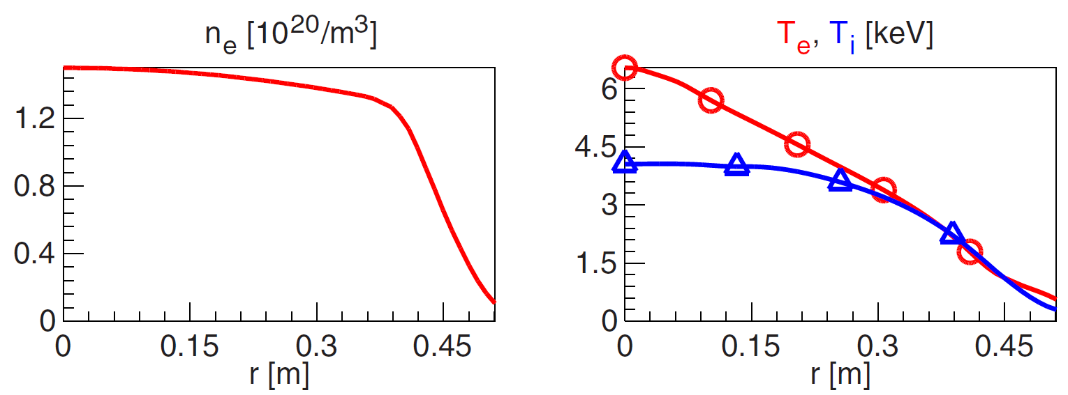
Example: W7-X edge.
Let’s revisit the W7-X scenarios from Turkin et al, PoP 18, 022505 (2011):

Slide 23
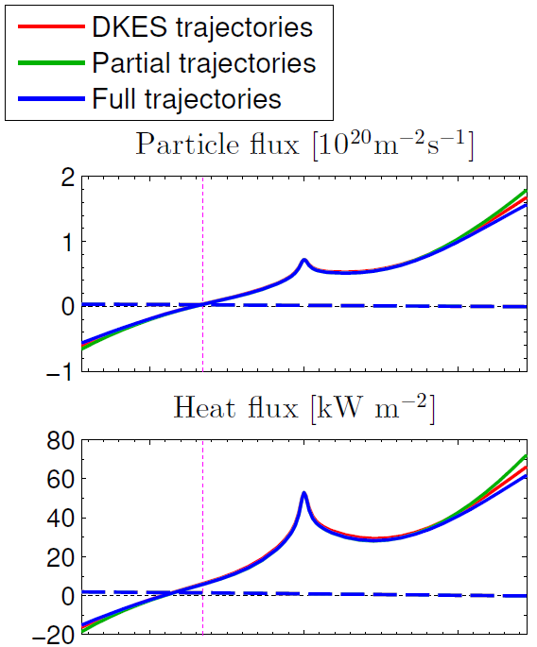
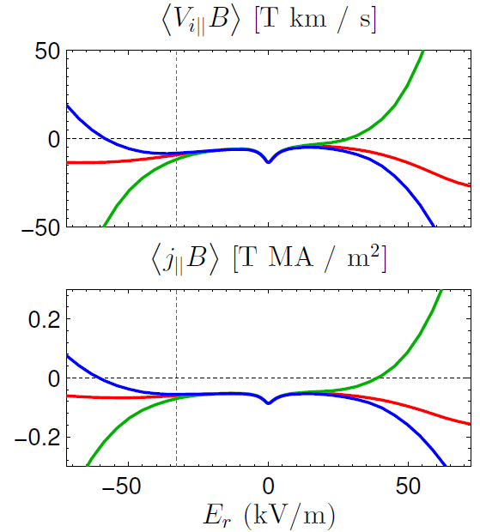

Example: W7-X edge. Trajectory model has little impact on ambipolar E_{r} , modest effect on j_{bs}
ions
electrons
ions
electrons
Notes:
Figure generated using m20131226_01_PlotSFINCS2SpeciesEScanForPowerpoint.m

Slide 24
Example: W7-X edge. Trajectory model has little impact on ambipolar E_{r} , modest effect on j_{bs}
ions
electrons
ions
electrons
Notes:
Figure generated using m20131226_01_PlotSFINCS2SpeciesEScanForPowerpoint.m

Slide 25
For the next few slides, we will consider the ion transport matrix L_{jk}

Slide 26
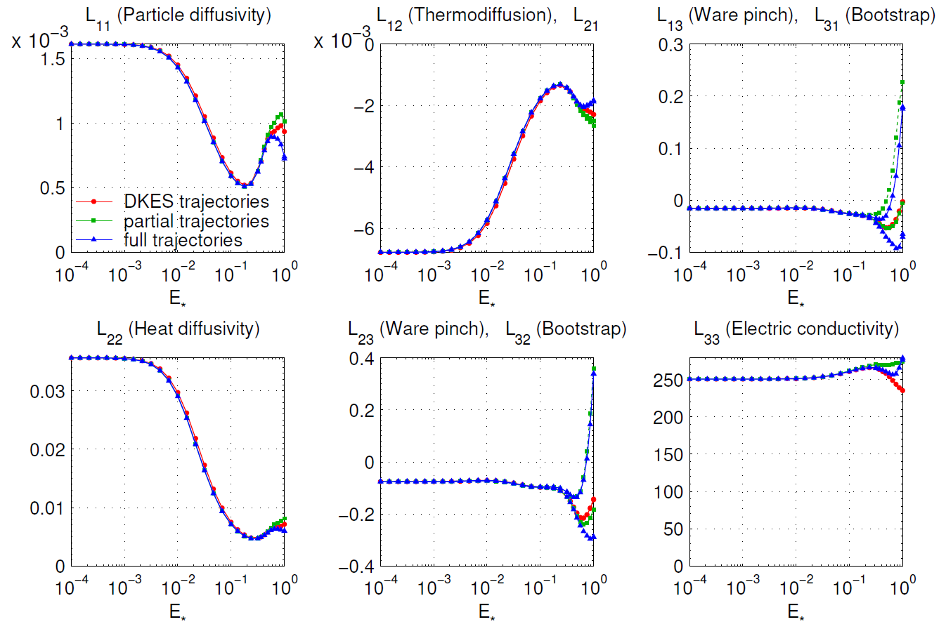
When E*=E_{r} /E_{r}^{res} is < 0.3, the 3 models are nearly identical; otherwise differences can be significant.
Notes:
Figure created using m20131224_01_plotSFINCSFortranErComparisonForPowerpoint.m

Slide 27
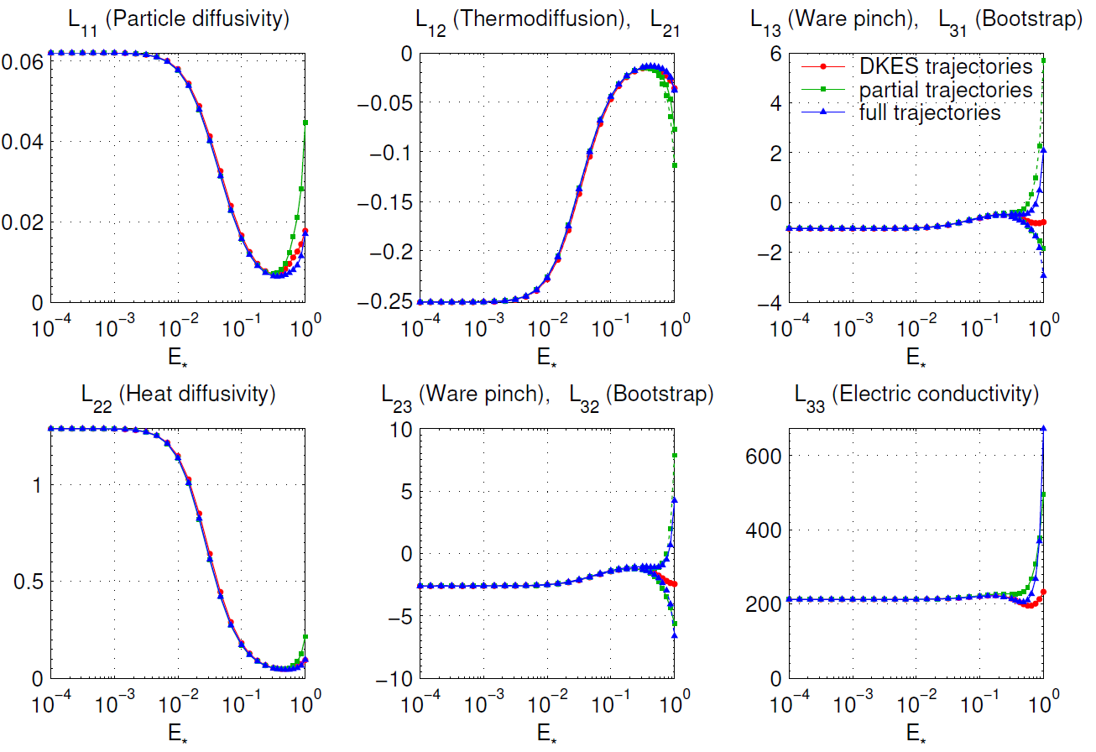
The same pattern is evident for LHD
Notes:
Figure created using m20131224_01_plotSFINCSFortranErComparisonForPowerpoint.m

Slide 28
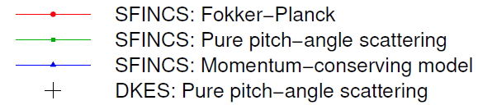
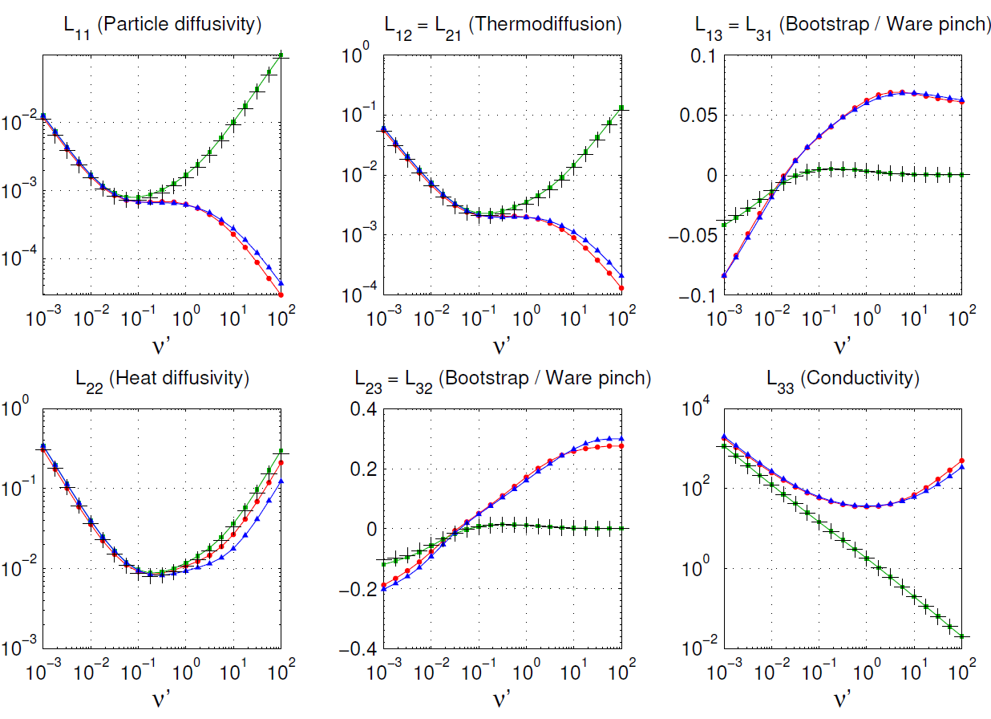
SFINCS allows comparison between collision operators
Notes:
Figure generated using m20131226_03_plotSFINCSAndDKESNuScansForPowerpoint.m

Slide 29
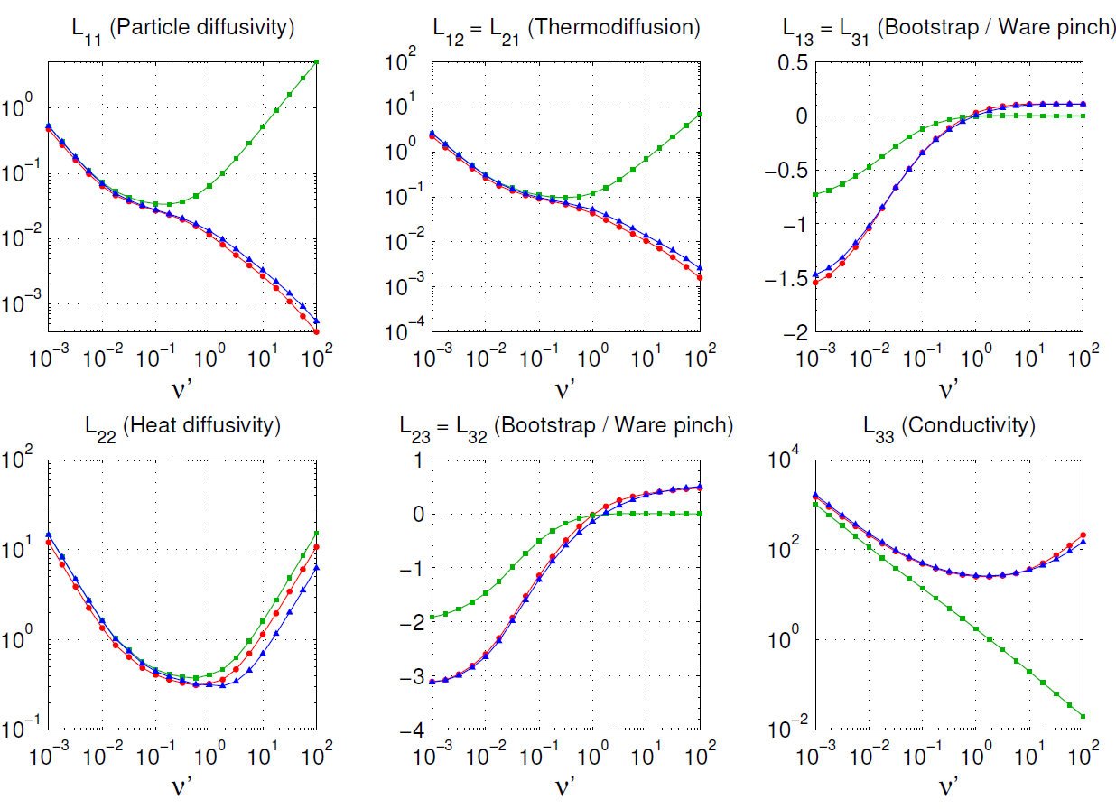
Similar patterns are apparent for LHD geometry
Notes:
Figure generated using m20131226_03_plotSFINCSAndDKESNuScansForPowerpoint.m

Slide 30
Summary
Our new code SFINCS allows a comparison of several variants of the drift-kinetic equation, differing in the E_{r} terms.
Below ~ 1/3 of the E_{r} resonance, the variants give nearly identical results.
For larger E_{r}/E_{r}^{res}, there are substantial differences, especially in the flows and j_{bs}.
The “full trajectory” model is probably the best of the 3 models considered here, but radial coupling could also be important.
Momentum conservation in collisions is always important for parallel flow and current. The full linearized Fokker-Planck operator gives results quite close to a momentum-conserving model.

Slide 31
Extra slides

Slide 32
For the next few slides, we will consider the ion transport matrix L_{jk}

Slide 33
New speed discretization is highly efficient
Spectral collocation method based on non-standard orthogonal polynomials in v, not v²:
Laguerre/Sonine polynomials lose accuracy because of nonanalytic √ in Jacobian at x = 0.

Slide 34
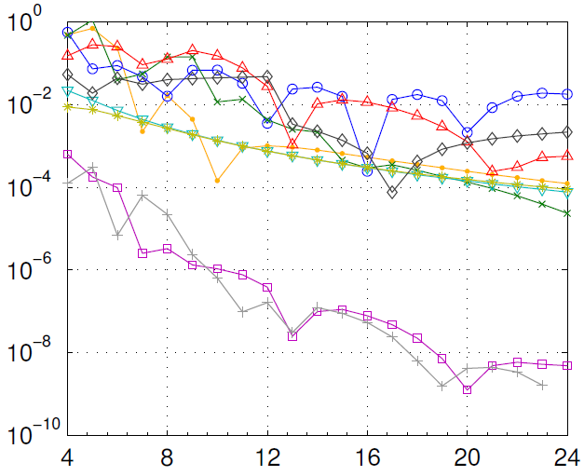
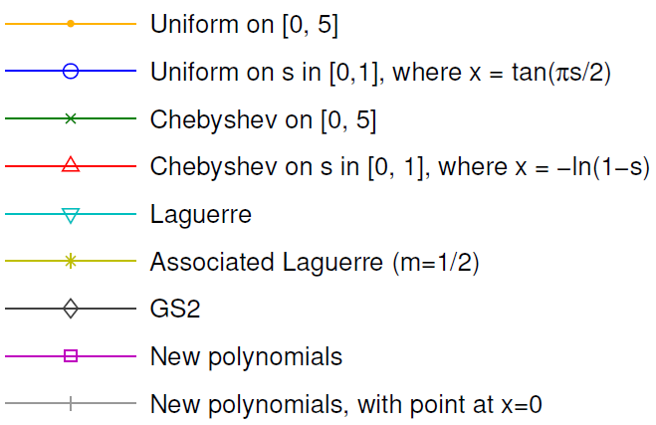
New speed discretization is highly efficient
Spectral collocation method based on non-standard orthogonal polynomials in v, not v²:
Laguerre/Sonine polynomials lose accuracy because of nonanalytic √ in Jacobian at x = 0.
1D problem: Spitzer resistivity
Relative error in Spitzer resistivity
Number of speed grid points
J Comp. Phys. 243, 130 (2013)

Slide 35
SFINCS can use the full linearized Fokker-Planck collsion operator.

Slide 36
SFINCS can use the full linearized Fokker-Planck collsion operator.
Vector of unknowns
Similar to independent work in Lyons et al, PoP 19, 082515 (2012)

Slide 37
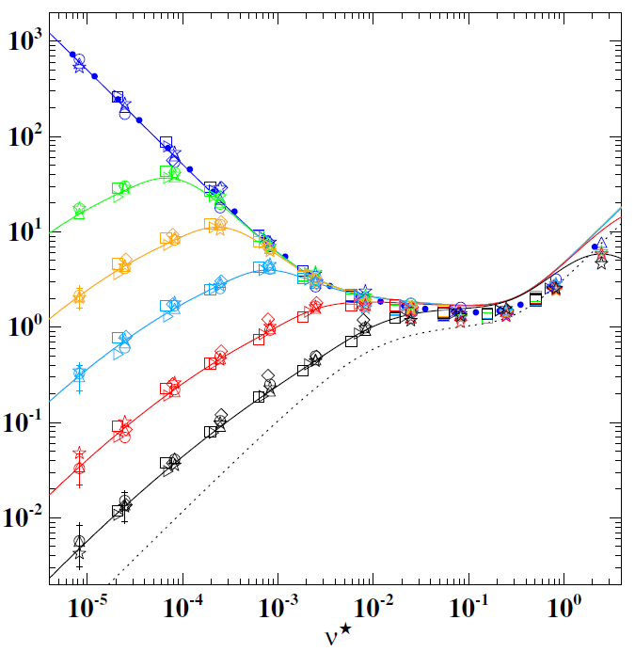
Computed radial neoclassical diffusivity in the LHD stellarator
“equivalent tokamak”
Beidler et al, Nucl Fusion (2011)
Collisionality

Slide 38
Unlike in tokamaks, collisionless trapped particle orbits are not generally confined.
It’s important to retain v_{E×B} in dr/dt; otherwise you lose poloidal precession & collisionless detrapping. A little bit of E_{r} (v_{E}  v_{th}) makes a big difference.
B = |B| on a flux surface
Trapped
orbits:
Trapped
particle
↓v_{E×B}
T
Poloidal angle
Direction of B
Toroidal angle

Slide 39
Helically trapped orbit
T
Poloidal angle
Direction of B
Toroidal angle
Toroidally trapped orbit
T
Poloidal angle
Direction of B
Toroidal angle

Slide 40
Comparison of particle trajectories and collision operators for collisional transport in nonaxisymmetric plasmas
Matt Landreman, (University of Maryland, MIT, ORISE)
Håkan Smith, Per Helander (IPP Greifswald)
arXiv: 1312.6058 (2013)
Notes:
Figure was generated using m20131226_02_sfincsNSpecies_pictureFor1stPowerpointSlide.m

